Slide 1
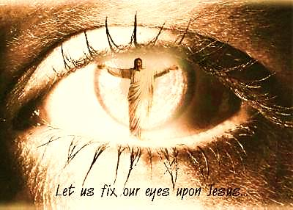
When We See Jesus Pt. 1 - COMFORT

Slide 2
Note: After you download the slideshow, you may also need to download some videos from YouTube & add them into this PowerPoint. This tool can help you: Free YouTube Download
We present these messages in outdoor venues using the SonShineTent. Watch the video of our service that goes with this message, click here: http://campaignkerusso.org/?p=5210
We would love to know more about the people who download our lessons & sermons. We invite you to email us & let us know where & how you use them.
info@campaignkerusso.org

Slide 3
Welcome All

Slide 4
Let’s Begin with Prayer

Slide 5
When We See Jesus Pt. 1 - COMFORT

Slide 6
Song: When We See Jesus
Video Goes Here Title: When We See Jesus Download Here:
http://youtu.be/M5jytluF9V4

Slide 7
Hearing Jesus creates FAITH in believers and…
SEEING Jesus can give us COMFORT

Slide 8
The William Montague Dyke Story
When William Montague Dyke was ten years old, he was blinded in an accident. Despite his disability, William graduated
from a university in England with high honors. While he was in school, he fell in love with the daughter of a high-ranking British naval officer, and they became engaged. Not long before the wedding, William had eye surgery in the hope that the operation would restore his sight. If it failed, he would remain… →

Slide 9
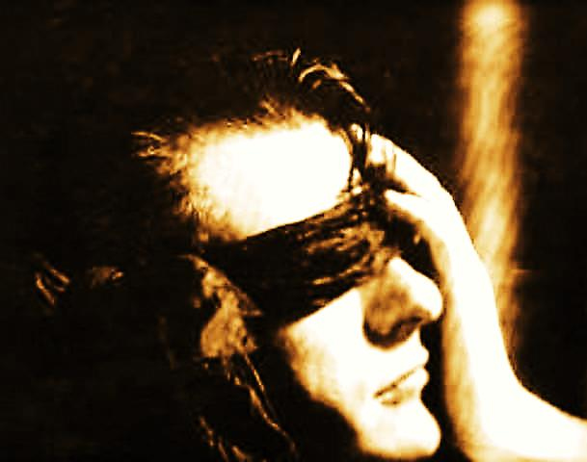
The William Montague Dyke Story cont.
…blind for the rest of his life. William insisted on keeping the bandages on his face until his wedding day. If the surgery was
successful, he wanted the first person he saw to be his new bride. The wedding day arrived. The many guests—including royalty, cabinet members, and distinguished men and women of society—assembled together to witness the exchange of vows. William’s father, Sir William Hart Dyke, and the doctor who performed… →

Slide 10
William Montague Dyke Story cont.
…the surgery stood next to the groom, whose eyes were still covered with bandages. The organ trumpeted the wedding march, and the bride slowly walked
down the aisle to the front of the church. As soon as she arrived at the altar, the surgeon took a pair of scissors out of his pocket and cut the bandages from William’s eyes. Tension filled the room. The congregation of witnesses held their breath as they waited to find out if William could see the woman standing before him. … →

Slide 11
The William Montague Dyke Story cont.
…As he stood face-to-face with his bride-to-be, William’s words echoed throughout the cathedral,
“You are more beautiful than I ever imagined!”

Slide 12
Our Wedding Day is Coming & We Will See Jesus
One day the bandages that cover our eyes will be removed. When we stand face-to-face with Jesus Christ and see His face for the very first time, His glory will be far more splendid than anything we have ever imagined in this life.

Slide 13
Jesus is present, in our lives right now, but mankind is spiritually blind. God is near, but people just don’t see Him.

Slide 14
Lies & Deception
Willfully Ignorant
Love Our Sin

Slide 15
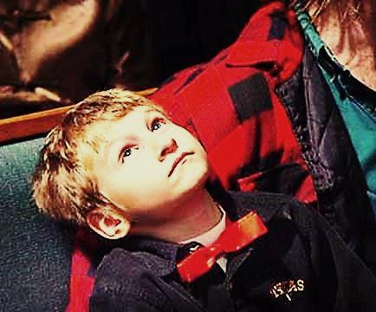
We can think we know all about Him – yet… have never seen him. We…
Hear other’s opinions
Read books
Parents & teachers tell us about Him
But, we need to see Him for ourselves with the faith eyes of our own hearts
We must behold His beauty ourselves and say for ourselves:
"You are more beautiful than I ever imagined!"

Slide 16
We can see our protector Jesus through eyes of faith!
At the beginning of His ministry, Jesus was introduced by His Father: “BEHOLD my Son”
John the Baptist: “BEHOLD the Lamb.”
We must open our faith eyes & SEE JESUS!

Slide 17
“God did this so that people would seek him. Then perhaps they would reach out for him and find him. They would find him even though he is not far from any of us..” Acts 17:27

Slide 18
Seeing Jesus in our circumstances elevates us above the fear
"The eagle that soars in the upper air does not worry itself how it is to cross rivers.” Gladys Aylward
She is the English missionary to China who, when Japan invaded China, led over 100 orphan children (though wounded herself) through rivers and over mountain tops to safety .
Troubles aren’t as scary when we see Jesus.

Slide 19
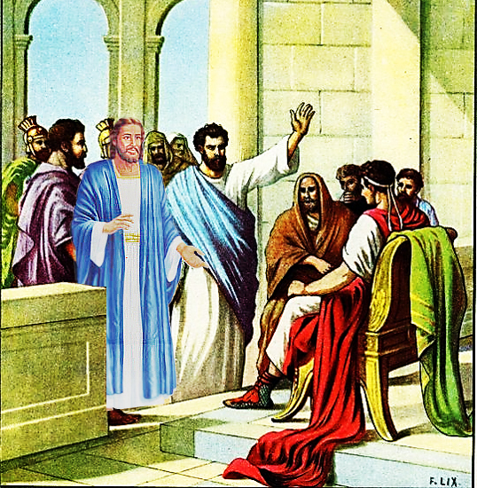
Seeing Jesus Transforms Our Problems
“When I first went to the court, no one stood with me to help me. Everyone left me....
But the Lord stood by me and gave me strength…”
2 Tim. 4:16, 17

Slide 20
“But Stephen was full of the Holy Spirit and he looked up to heaven.
He saw God’s glory. And, he saw Jesus, who was standing
at God’s right side.
‘Look’, Stephen said. ‘I see heaven. It is open. And I see the Son of Man, who is standing at God’s right side.” Acts 7:54-57

Slide 21
“…It was now dark, and Jesus had not yet come to them. The sea became rough because a strong wind was blowing.
When they had rowed about three or four miles, they saw Jesus walking on the sea and coming near the boat, and they were frightened.
But he said to them, “It is I; do not be afraid.”
John 6:16-21

Slide 22
A Picture of Mankind
Life can be like a troubled sea.
We are in a in a small boat (our bodies).
It’s dark and we don’t know how to get to Heaven.
We don’t have Jesus in our boat yet.

Slide 23
A Picture of Mankind
The storms of life rock our tiny boat.
We try to make it on our own (rowing harder).
Then we see Jesus.
At first we may fear him.
Then, if ee let Him in our boat.
Immediately, we are safe & home.

Slide 24
Song: What a Day That Will Be
Video Goes Here Title: What a Day That Will Be
Download Here:
http://youtu.be/7j3rjg-YU7s

Slide 25
Is Jesus
Speaking to You?
“They said to each other, ‘Did not our hearts burn within us while he talked to us on the road, while he opened to us the Scriptures?’”
John Wesley Said:
“…the preacher was describing the change which God works in the heart through faith in Christ and I felt my heart strangely warmed.”
Jesus makes His presence Known by a small voice!

Slide 27
What is the Sinner‘s Prayer?
This is a prayer we can pray when we are ready to admit we are sinners and need Christ’s forgiveness.
It must be prayed with faith in our hearts and a readiness to have a life-changing encounter with Jesus Christ.

Slide 28
A prayer of faith → Pray this prayer if :
If you never have before
You have in the past, but you think it would mean more today
You have been walking afar off and you want to come back
You want to set an example & show others how it is done
You just like to give your heart to Jesus again & again
Faith

Slide 29
We Declare Our Faith Publicly Because Jesus Declared His LOVE Publicly
“If you stand before others and are willing to say you believe in me, then I will tell my Father in heaven that you belong to me.” Mat 10:32

Slide 30
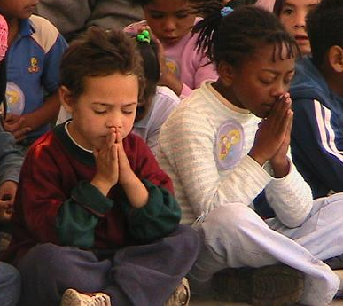
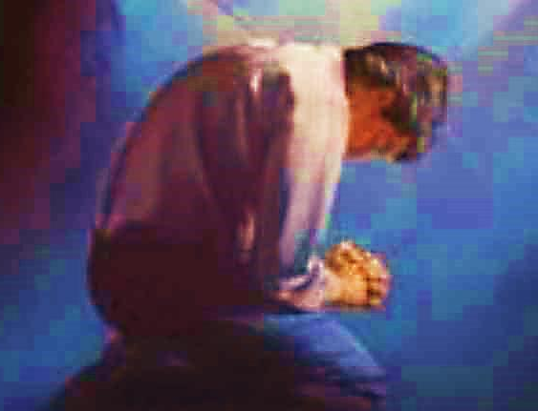
Three Important Questions
Do you want to know Jesus as your Savior right now?
Do you believe He died to save you from your sins & that He rose from the dead?
Do you believe that He is here, waiting to save you right now?

Slide 31
The Prayer of a Sinner Turning to Jesus
Dear Jesus, I know that I have sinned against You and that my sins separate me from You.
I am truly sorry.
Right now, I turn away from my sinful past .
Please forgive me, and help me to keep from sin.
I believe You died for my sins.
I Believe You rose from the dead, you are alive, and you hear this prayer from my heart.
I invite You Jesus to be both my Savior and the Lord of my life.
I want You to rule my life from now on.

Slide 32
“But some people did accept him. They believed in him, and he gave them the right to become children of God.”
John 1:12

Slide 34
“If you openly say, ‘Jesus is Lord’ and believe in your heart that God raised him from death, you will be saved.”
Rom. 10:9
What did you learn today?
What about Seeing Jesus?
What have you been thinking about God lately?
What do you want to tell others about Jesus?

Slide 35
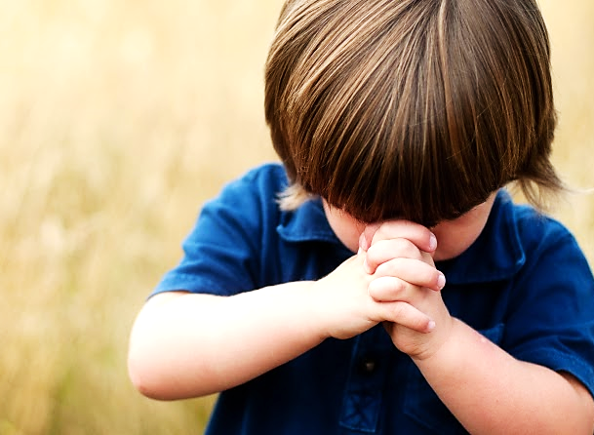
Let’s Close in Prayer

Slide 36
Note: After you download the slideshow, you may also need to download some videos from YouTube & add them into this PowerPoint. This tool can help you: Free YouTube Download
We present these messages in outdoor venues using the SonShineTent. Watch the video of our service that goes with this message, click here: http://campaignkerusso.org/?p=5210
We would love to know more about the people who download our lessons & sermons. We invite you to email us & let us know where & how you use them.
info@campaignkerusso.org

